Slide 1
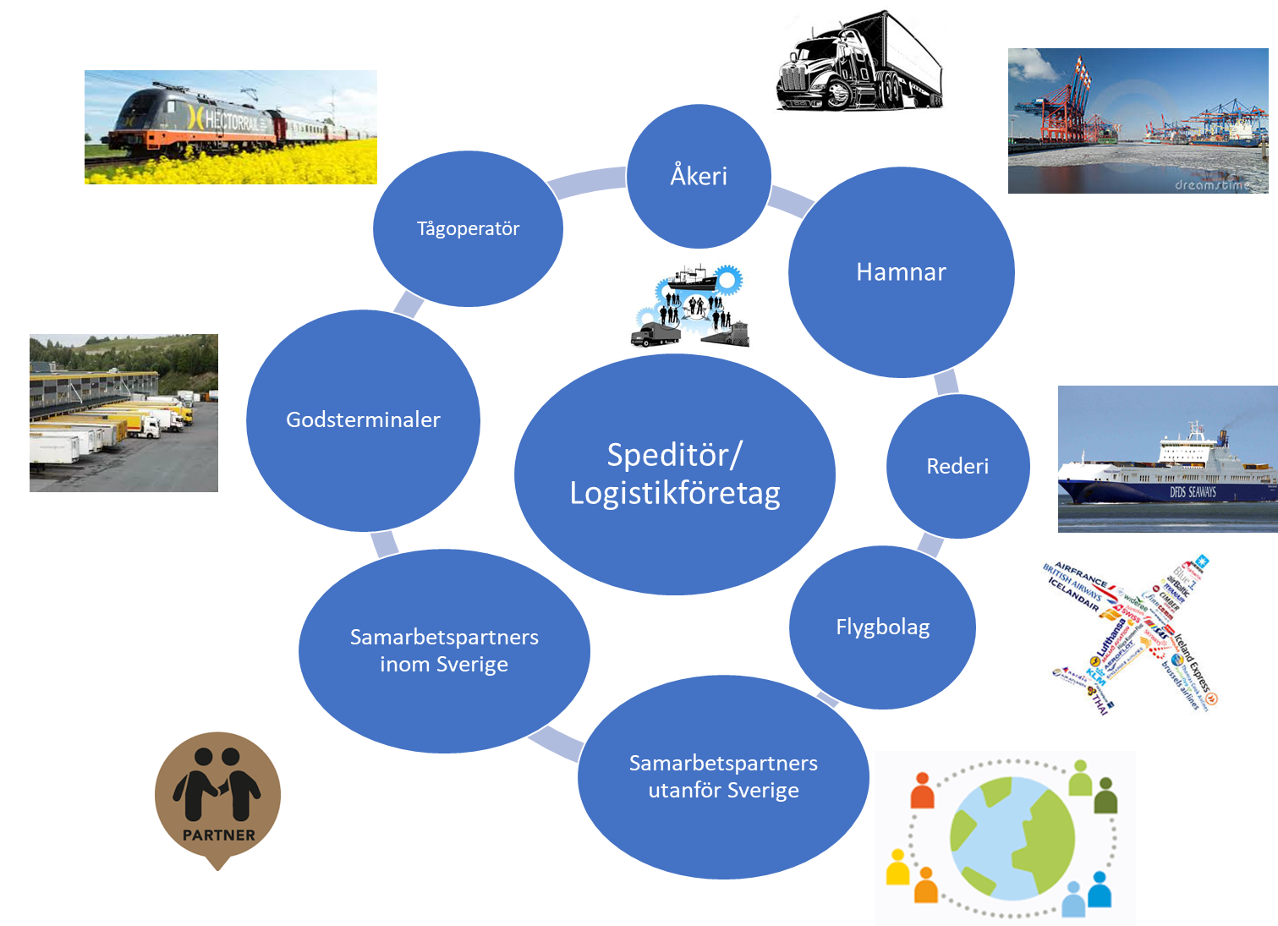
Notes:
Use this is image

Slide 2





Logistics actors
Domestic
"The big five "
Dedicated haulage companies
Subcontractors

Slide 3
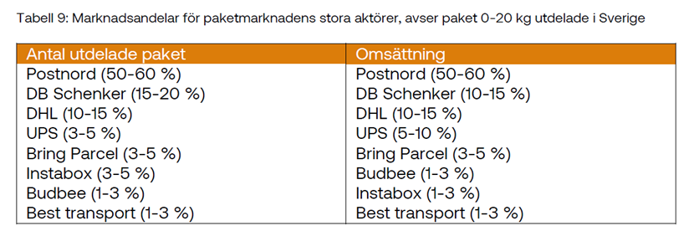
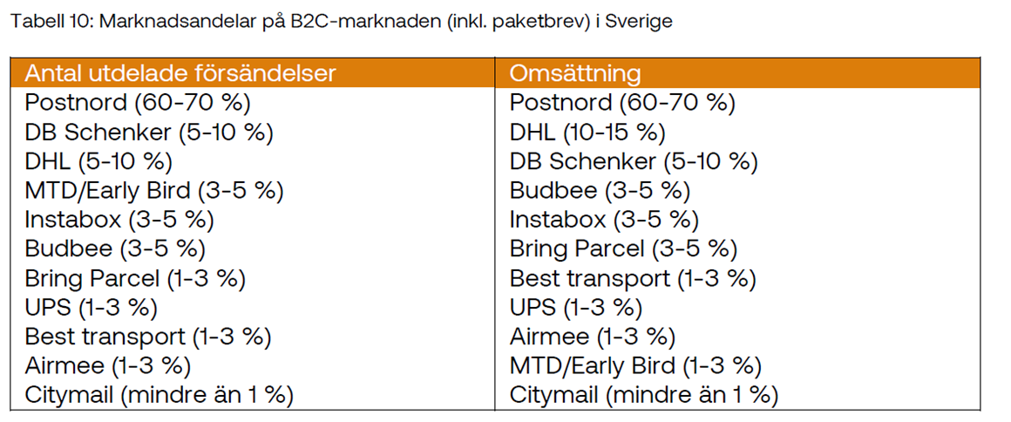
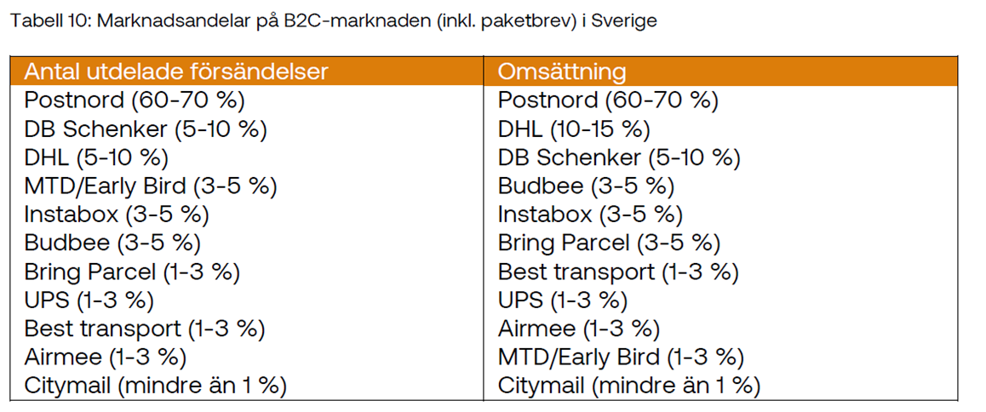
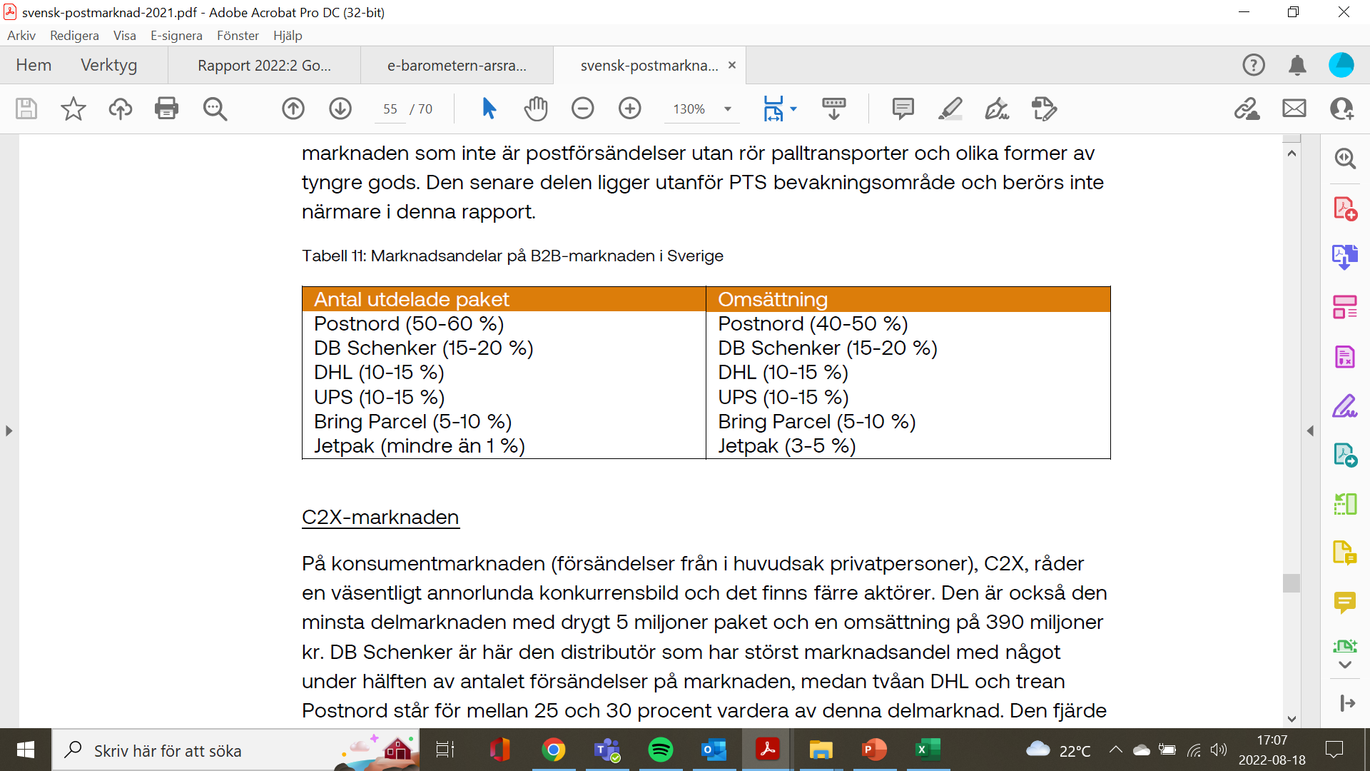
Deliveries B2B and B2C
Statistics 2022
Domestic transport 492,464,000kg
Package included
B2B and B2C
A total of 295 million packages
43 million international parcels
Predominant part of the business
DHL, Schenker
B2B approx. 80%
Source: Swedish postal market 2022.
Mail and telephoneboard

Slide 4
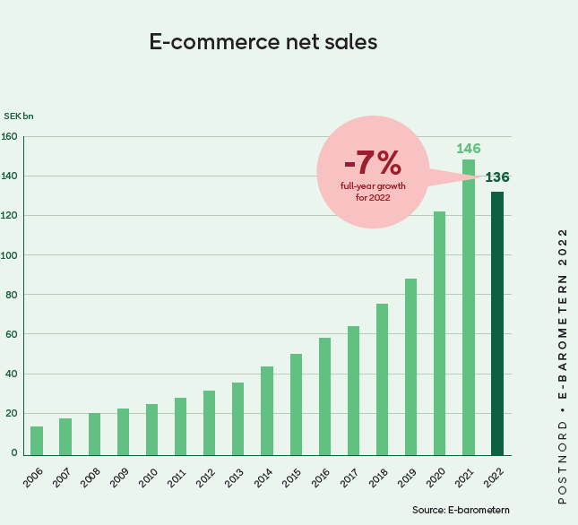
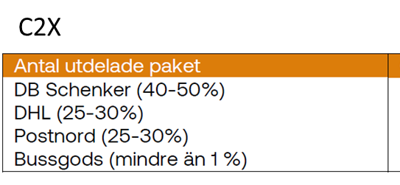
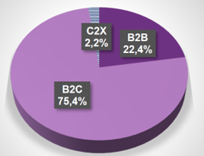
Deliveries B2B, B2C and C2X
C2X = deliveries between private individuals
Conclusion
E-commerce packages constitute a lot
small percentage of the total freight volumes
The market decreased by 7% in 2022

Slide 5

Deliveries B2B, B2C and C2X
Consolidation
Long-distance transport
Challenges
"last mile"
Of private persons
Little knowledge of logistics
Little understanding
Digitization
Delivery times/opening hours
City deliveries
sustainability
Consolidation
Delivery times

Slide 6
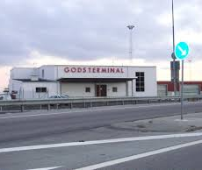
Terminal system and transport system domestically
Terminals
HUB terminal
Port terminal
Ferry terminal
Airport terminal
Combi terminal
Freight terminals

Slide 7
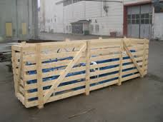
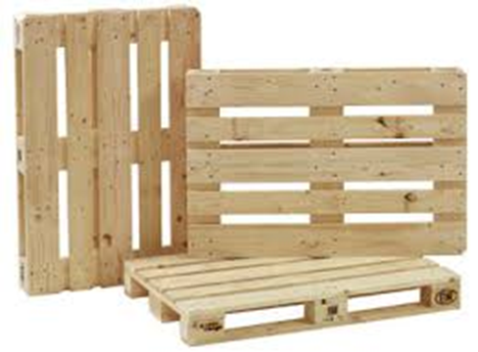

Transport units
The freight terminal handles transport units
A hot that goods can be loaded in, for example
Stool
Box
Hedge
Cardboard
Barrel
Feature
Keep the goods together
Be carrying
Protective
Load securing
Physical requirements
Size
Time
Form
Management
EUR pallet 1.20 mlx 0.80 m b

Slide 8
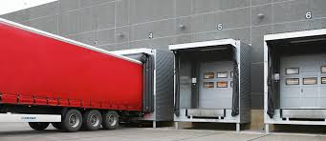
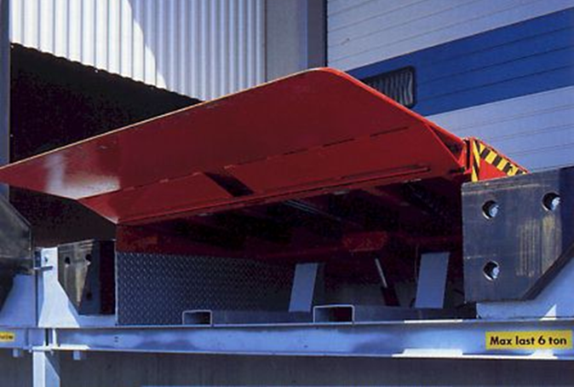
Terminal system and transport system domestically
Terminal operations
Capacity
Day
Loading/Unloading
Piers
loading dock
Courtyard

Slide 9
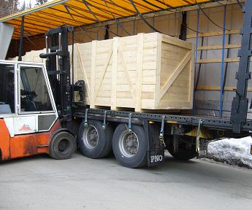
Terminal system and transport system domestically

Slide 10
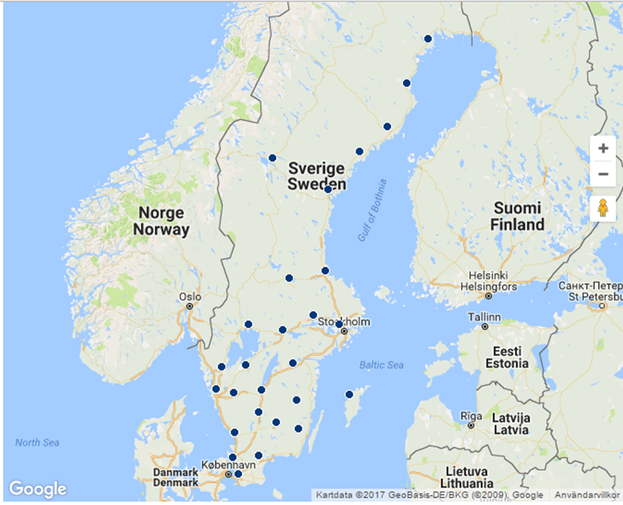
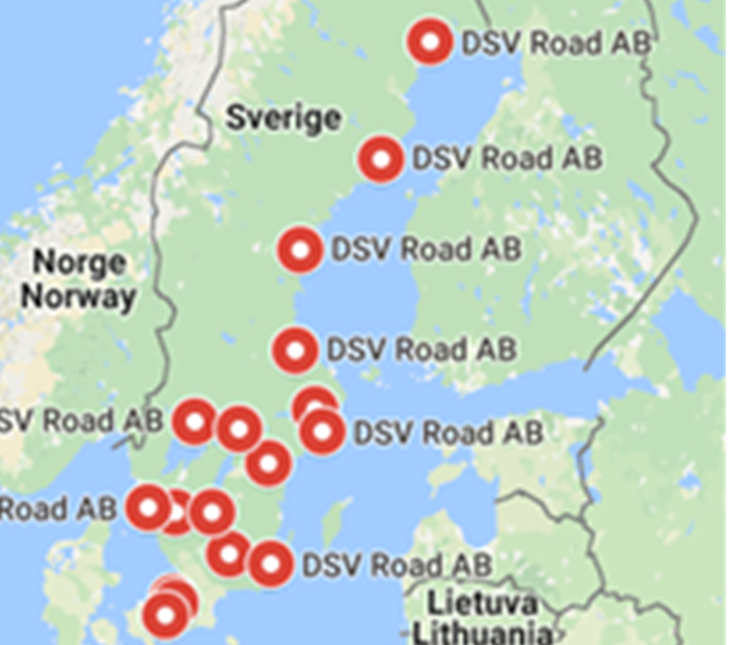
Terminal system and transport system domestically
Schenker
DSV

Slide 11
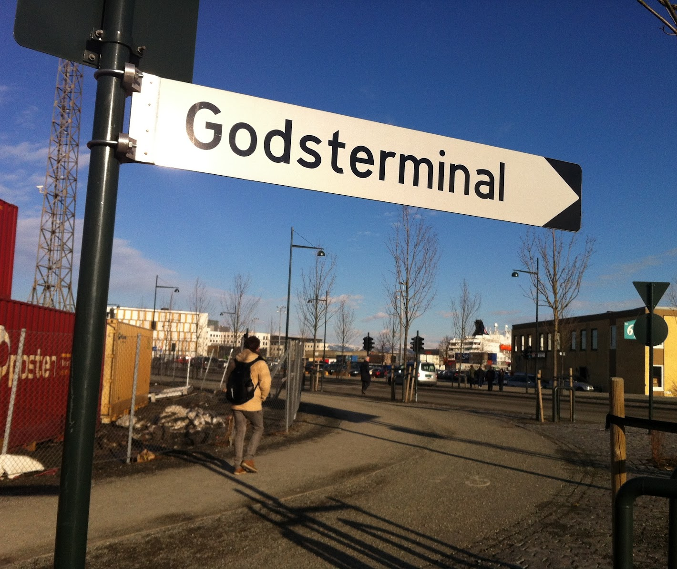
Terminal system and transport system domestically
Freight terminal
Can be owned by
DHL, Schenker, DSV, Postnord, Bring
Dedicated subcontractor to
DHL, Schenker, DSV, PostNord, Bring
Completely standalone
Owned of haulage
LBC
Terminal company
Real estate company
Rent out to
Terminal company
Logistics company

Slide 12
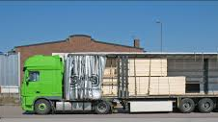
Terminal system and transport system domestically
Freight terminal
Domestic operations
Reloading
The estate changes vehicles
On/off distribution vehicles
On/off remote transport vehicles
Reloading of consignment goods
For better route planning
Stores the goods for a short time

Slide 13
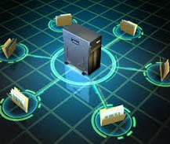
Terminal system and transport system domestically
Freight terminal
Unloading
Waybill
Digital or analogue
Discharge list
Placement of goods in goods terminal
Godstorg
Scaffolding

Slide 14
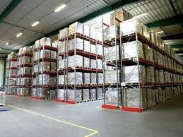
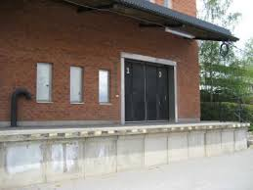
Incoming
Gate 1
Gate 2
Gate 3
Gate 4
Gate 5
Scaffolding
Reception area
Umeå, Luleå | Gävle Sundsvall | Karlstad | Kalmar, Växjö
Norrköping | Stockholm | Jönköping | Malmö
Scaffolding
loading dock
Scaffolding
Gate 6
Gate 7
Gate 8
Gate 9
Gate 10
Departing

Slide 15


Terminal system and transport system domestically
Goods quantities
Package
< 100 kg
General cargo
< 2500 kg
Party goods
> 2500 kg
Hellest, full car
> 20,000 kg

Slide 16
Sender Brandon AB, Malmö
Transport system domestic road transport
consignment goods
20 pll 15575kg
Transport Fjarraker
Brandon/Malmö
Puma AB Stockholm
Recipient Puma AB Stockholm

Slide 17
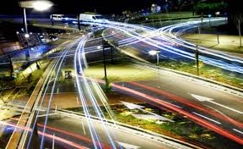
Terminal system and transport system domestically
Road transport
General cargo, up to 2500kg
Distribution vehicles
Pick up and deliver
Via freight terminal
Collected
With other customer goods

Slide 18
Sender Brandon AB, Malmö
Transport system domestic road transport
piece goods
2 ppl 575kg
Domestic booking, eg DHL
Goods terminal Stockholm
Distribution haulage
Local transport
Local transport
Distribution haulage
Consolidation Stockholm
Goods terminal Malmö
Long-distance haulage
Long distance transport
Recipient Puma AB Stockholm

Slide 19
Sender Brandon AB, Malmö
Transport system domestic road transport
piece goods
2 ppl 575kg
Domestic booking, eg DHL
Goods terminal Gävle
Consolidation to, for example, Mora
Distribution haulage
Local transport
Long distance transport
for example to Mora
Long-distance haulage
Goods terminal Malmö
Goods terminal Mora
Long-distance haulage
Long distance transport
Local transport
Local transport company
Time consumption
1 – 2 days
Recipient Sportbutiken AB Orsa

Slide 20
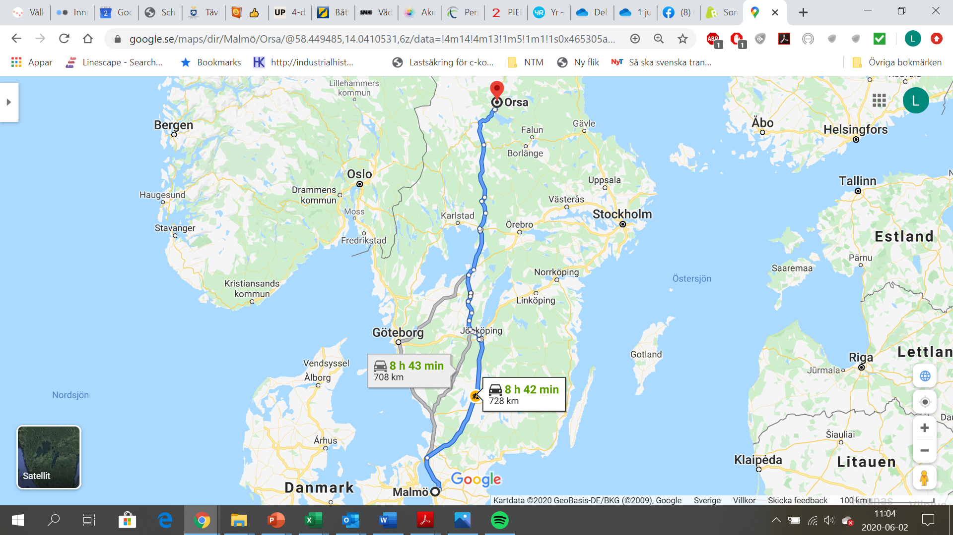
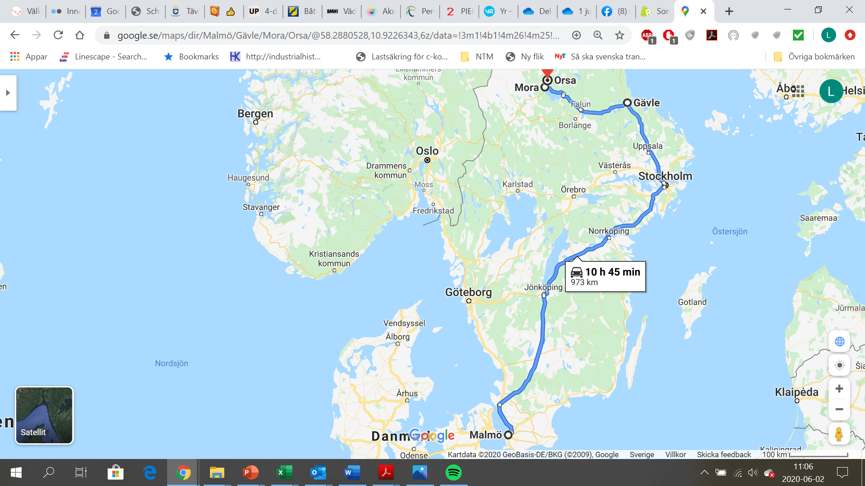

Slide 21

Terminal system and transport system domestically
Parties
Sender
Booking and planning
Freight terminal
Dispatch area
Local transport driver
Remote skier
Reception area
Freight terminal remote
Goods terminal premises
Remote skier
Local transport driver
8 - 10 parties

Slide 22
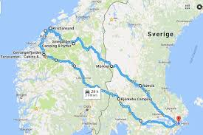
Terminal system and transport system domestically
What is behind the price of a domestic transport?
Route planning
Degree of filling
Reloading
Waiting times
Vehicle
Digitization

Slide 23

Terminal system and transport system domestically
How is the transport system controlled?
DHL, Schenker etc
Digitally
The rider gets access to internal IT systems
Part in agreement
The intermediary and LBC
Digitally
Independent IT system
Communication via smartphones
Manual handling
Paper waybills

